Slide 1

IOT BASED EUTROPHICATION MONITORING SYSTEM
Batch Number : 91
Tamilselvam P (312317106180)
Venkatesh A (312317106187)
Guide: Dr. D. Lakshmi
Associate Professor
Department of Electronics & Communication Engineering, St.Joseph’s College of Engineering,
Chennai-119

Slide 2
Objective
To monitor the day to day parameters in lakes to control pollution levels and save life under water.
To diagnose Eutrophication at earlier stage.

Slide 3
ABSTRACT
Monitoring of the water body parameters through IoT cloud from a remote location periodically.
Analyzing the parameters received and comparing it with the desired to activate the warning system.

Slide 4
Motivation
There are 909 freshwater lakes in integrated Kanchipuram district in Tamil Nadu.
Due to rapid urbanization and increase in population, most lakes are polluted.
Once a lake is eutrophicated, it takes minimum a complete year to regain the old nature of the lake.
This happens only if there is sufficient rain in that year and the lake gets replenished with freshwater again.
Eutrophication occurs when a body of water develops a surplus of nutrient and phosphorus, often from pollutants.

Slide 5
Motivation (cont..)
The excess phosphates allow for the rapid growth of algae and plankton.
When these organisms die, they potentially consume oxygen from the water, causing a state of hypoxia where the water can no longer support aquatic life.
The algal bloom or Eutrophication caused by Enteromorpha prolifera, is not toxic to humans or animals.
But due to the depletion of Oxygen the fish and other marine life gets distributed.

Slide 6
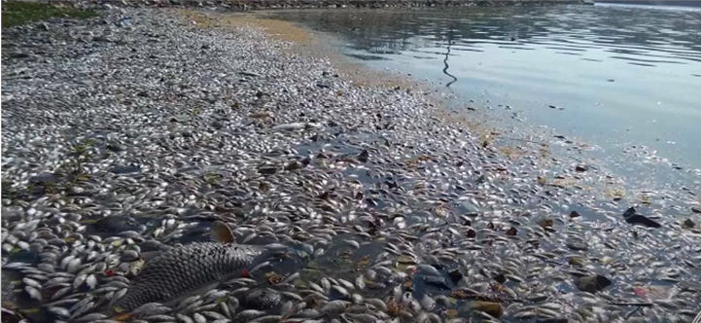
how does it affect us ????

Slide 7
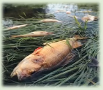
Impacts on Environment
ECONOMIC
# Fish and other marine life death- loss of money/ business and food.
# Affects Tourism.
HEALTH
# The Ecological cycle would get damaged.
# Water becomes toxic and would affect the human health on direct and indirect consumption.

Slide 8
Literature Survey
Title | Authors | Year | Overview
IoT Application for Water Quality Monitoring: Nitrates | Laura Hernández-Alpizar, Arys Carrasquilla-Batista, Lilliana Sancho-Chavarría | 2020 | An autonomous system for nitrates remote monitoring that uses an adjustable but continuous sampling flow, UV spectroscopy and Internet of Things (IoT) to directly perform and control the system calibration and nitrates quantification and, a strategy to optimize data generation and the monitoring resolution
Development of IoT for Automated Water Quality Monitoring System | Rizqi Putri Nourma Budiarti , Anang Tjahjono, Mochamad Hariadi | 2019 | The system monitoring of Automated Water Quality Device using passive and active sensors using Python serial programming. Then transmission the data to the database system using MQTT protocol.
Intelligent sensor based monitoring system for underwater | S.Premkumardeepak, Dr.M.B Mukesh Krishnan | 2017 | This system holds the temperature sensors, humidity sensors, pressure sensors wind sensors and chemical sensors with this sensor, the identification of pollution in done and the data is transfered to monitoring system.

Slide 9
Existing System and its Limitations
There are several such water monitoring systems in use, but it requires a PWD team to visit the lake and sensors will be used to measure the data.
But the frequency of monitoring will be very low.
Hence an immediate action cannot be taken with inadequate and old information.
This will surely increase the risk of eutrophication.
Due to the vast number of lakes in the district, monitoring the water pollutant levels is difficult.
But if the change in pollution level is noted at an early stage, eutrophication can be avoided.

Slide 10
Proposed System
The proposed system is an IOT based eutrophication monitoring beacon, which will measure the pollution levels using turbidity, PH, conductivity, and gas sensors.
The beacon observes the parameters thorough the sensor connected to the the electronic systems on it.
The collected sensor data is sent immediately uploaded to the cloud, directly by the beacon, which can be viewed from webpage created.
The entire system is powered by an onboard battery.
A warning will be produced when the desired levels are found inappropriate.

Slide 11
Desired Values (Issued by BIS & CPCB)
 | Drinking | For Fishes
Nitrate | 10 ppm | 1-2 ppm
pH | 6.5 to 8.5 | 6.0 to 9.0 (BIS 1998)
Turbidity | < 1 NTU | 10 NTU
Dissolved Oxygen | 6.5-8 ppm | > 4 ppm
Ammonia | 0.5 ppm | 0-1 ppm

Slide 12
Block Diagram
Power Source
Arduino UNO
Temperature sensor
LCD
Buzzer
Ph Sensor
Turbidity sensor
IoT Webpage

Slide 13
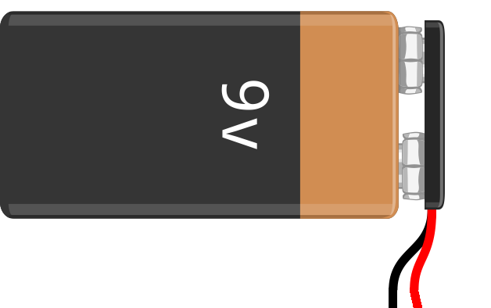
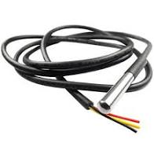
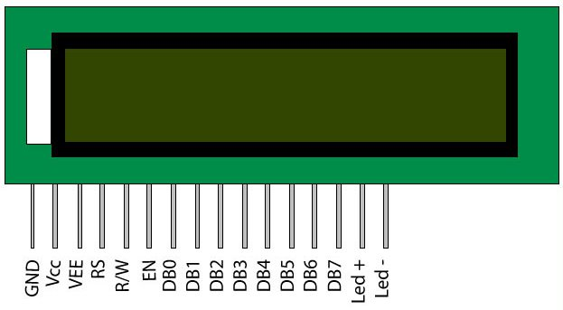
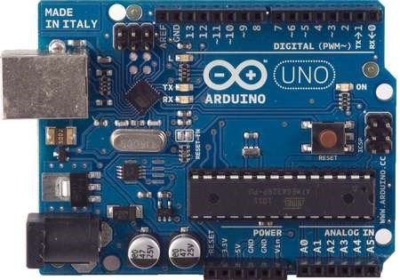
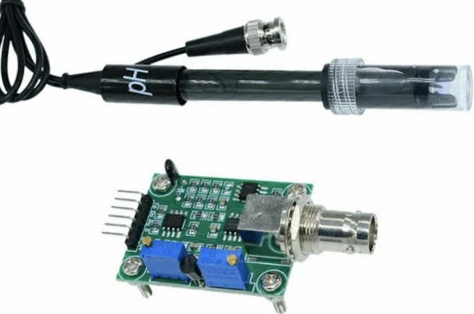
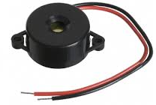
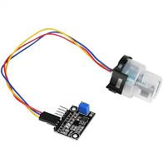
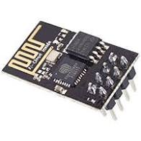

Slide 14
Flow Diagram
Environment(Lake)
Sensor
Internet
Cloud Server
Monitoring centre

Slide 15
Hardware Components:
Power Supply
Temperature sensor
pH sensor
Turbidity sensor
LCD
Wifi Module (ESP8266)
Buzzer

Slide 16
ARDUINO UNO

Slide 17
Input Voltage (limits) 6-20 V
Digital I/O Pins 14 (of which 6 provide PWM output)
Analog Input Pins 6
DC Current per I/O Pin 40 mA
DC Current for 3.3V Pin 50 mA
Flash Memory 32 KB of which 0.5 KB used by bootloader

Slide 18
Arduino uno and its programming
Arduino is a tool for making computers that can sense and control more of the physical world than your desktop computer. It's an open-source physical computing platform based on a simple microcontroller board, and a development environment for writing software for the board.
Arduino can be used to develop interactive objects, taking inputs from a variety of switches or sensors, and controlling a variety of lights, motors, and other physical outputs.

Slide 19
Cont..
Arduino projects can be stand-alone, or they can be made to communicate with software running on the computer. The boards can be assembled by hand or purchased preassembled; the open-source IDE can be downloaded for free.
The Arduino programming language is an implementation of Wiring, a similar physical computing platform, which is based on the Processing multimedia programming environment.

Slide 20

DS18B20 water proof temperature sensor:
A waterproof probe style which can be more useful when measuring something far away, underwater or under the ground. DS18B20 temperature sensor is fairly precise and needs no external components to work. It can measure temperatures from -55°C to +125°C with ±0.5°C Accuracy.
Temperature Range: -55 to 125°C
Accuracy: ±0.5°C
Power Supply: 3V to 5.5V
Resolution: 9 to 12 bit (selectable)

Slide 21
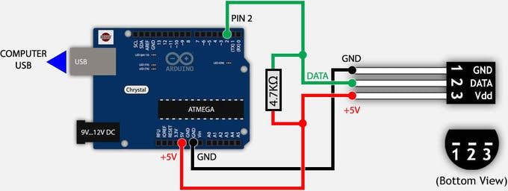
Connecting with arduino

Slide 22
Turbidity Sensor
The turbidity unit is measured in NTU “Nephelometric Turbidity Units” which is global standard. The larger the turbidity is, the cloudy of the sample is. Turbidity sensor connects to the microcontroller through an analog to digital converter through this A to D converter.
The output signal can be switched between analog and digital. Under analog mode the signal wire from A to D converter goes to the analog input pin on the microcontroller. The turbidity is represented by the voltage of the output pin.
Clear water with NTU less than 0.5 give us a voltage around 4.1 volts.
NTU: 500 Voltage: 3.27V
NTU: 50 Voltage: 4.10V
NTU: 0.5 Voltage: 4.21V

Slide 23
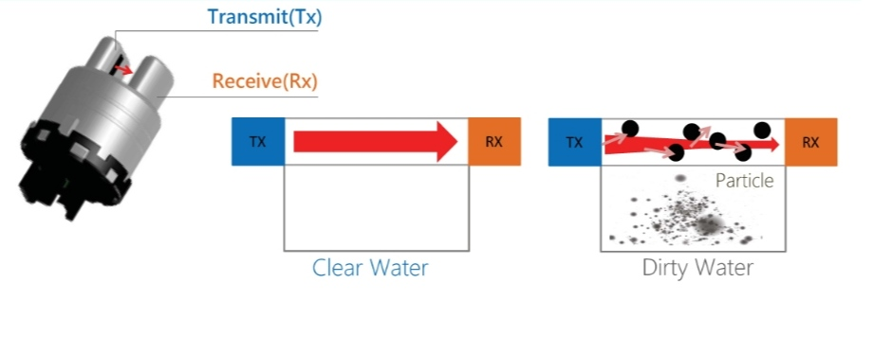
Turbidity Sensor:

Slide 24
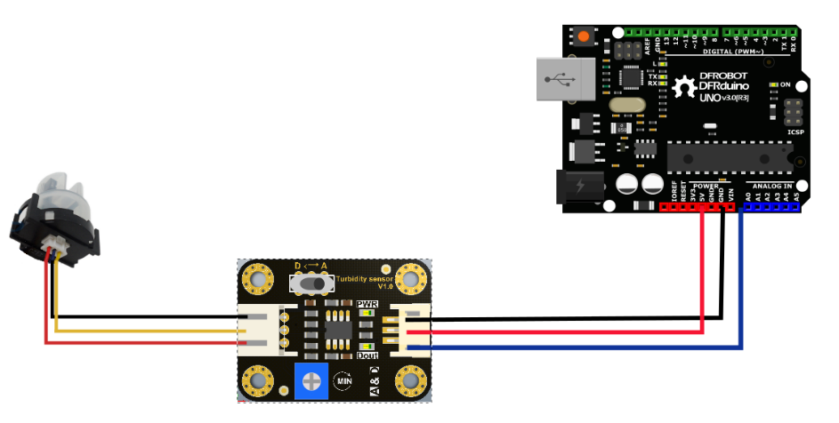
Connecting with arduino

Slide 25
Ph sensor
The unit that we use to measure the acidity of a substance is called pH. The term “H” is defined as the negative log of the hydrogen ion concentration. The range of pH can have values from 0 to 14. A pH value of 7 is neutral, as pure water has a pH value of exactly 7. Values lower than 7 are acidic and values greater than 7 are basic or alkaline.

Slide 26
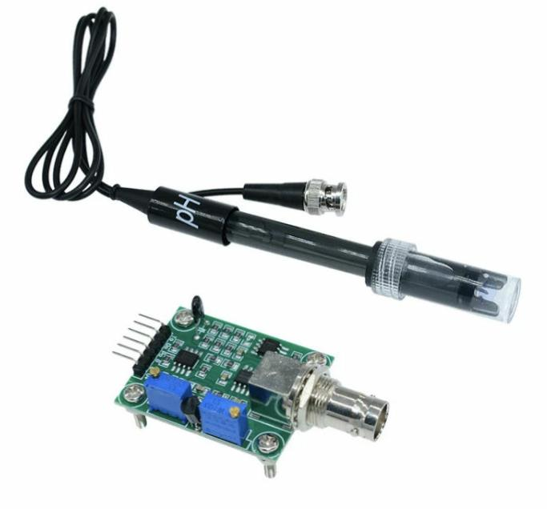
Ph sensor

Slide 27
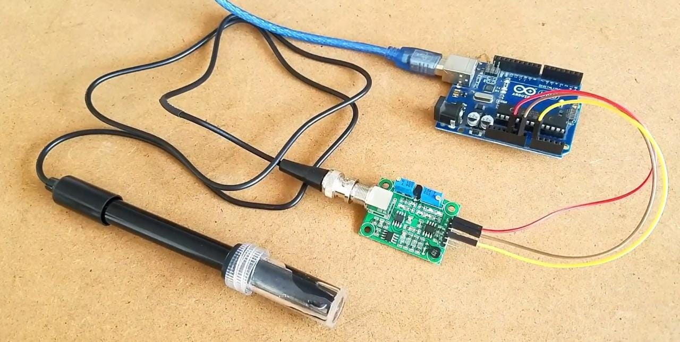
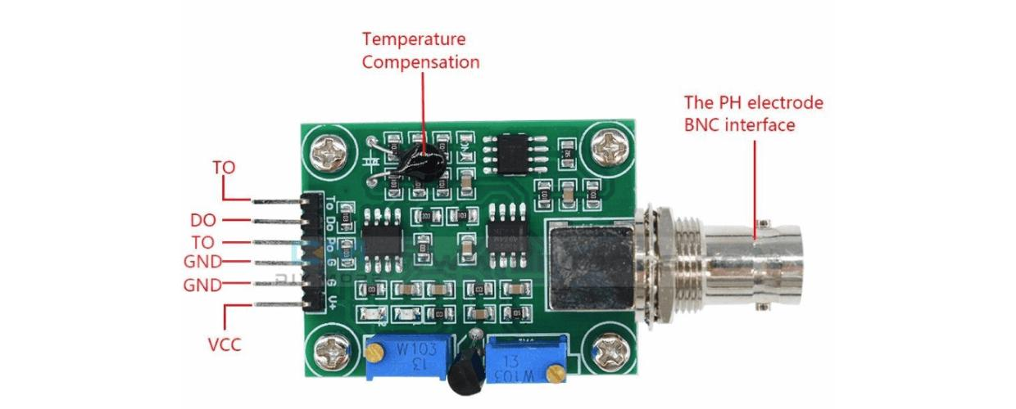
Connecting with arduino

Slide 28
LCD
The 16x2 LCD used in this experiment has a total of 16 pins. Eight of the pins are data lines (pins 7-14), two are for power and ground (pins 1 and 16), three are used to control the operation of LCD (pins 4-6), and one is used to adjust the LCD screen brightness (pin 3). The remaining two pins (15 and 16) power the backlight.The details of the LCD terminals are as follows:

Slide 29
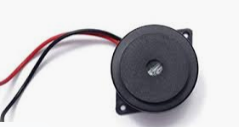
Buzzer
A buzzer or beeper is an audio signalling device, which may be mechanical, electromechanical, or piezoelectric (piezo for short). Typical uses of buzzers and beepers include alarm devices, timers, and confirmation of user input such as a mouse click or keystroke

Slide 30
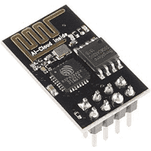
ESP8266 Wifi module
The ESP8266 WiFi Module is a self contained SOC with integrated TCP/IP protocol stack that can give any microcontroller access to your WiFi network. The ESP8266 is capable of either hosting an application or offloading all WiFi networking functions from another application processor.

Slide 31
Software Components:
Embedded C
Thingspeak Cloud

Slide 32
EMBEDDED C
Embedded C Programming is the soul of the processor functioning inside each and every embedded system we come across in our daily life, such as mobile phone, washing machine, and digital camera.
Each processor is associated with an embedded software. The first and foremost thing is the embedded software that decides functioning of the embedded system.
Embedded C language is most frequently used to program the microcontroller .

Slide 33
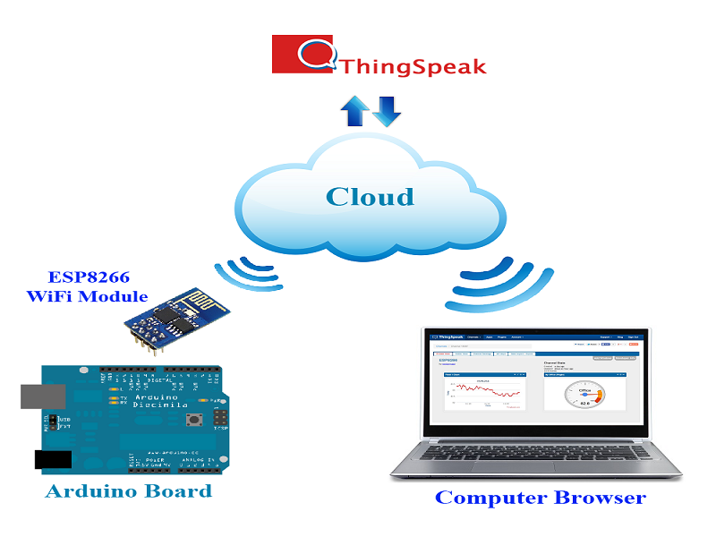
ThinkSpeak
ThingSpeak is an IoT analytics platform service that allows you to aggregate, visualize and analyze live data streams in the cloud. ThingSpeak provides instant visualizations of data posted by your devices to ThingSpeak. ... ThingSpeak is often used for prototyping and proof of concept IoT systems that require analytics.

Slide 34
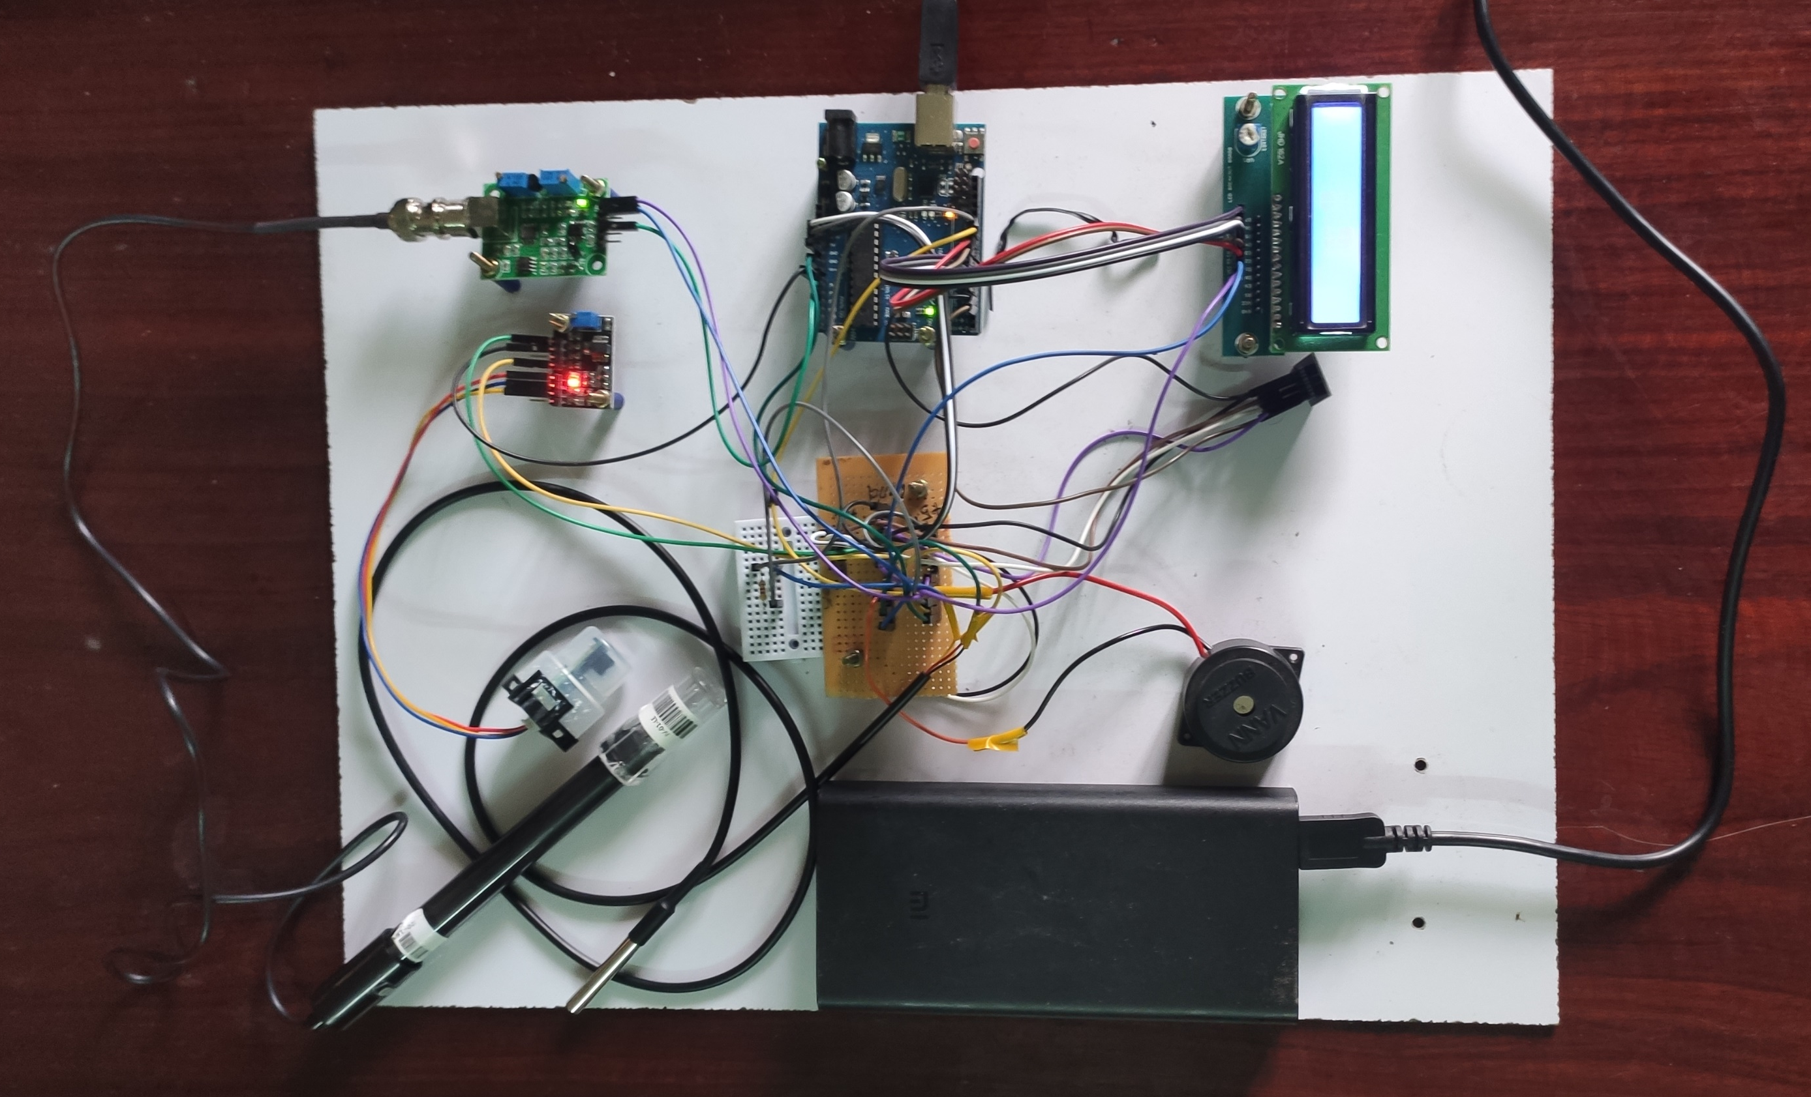
Project setup

Slide 35
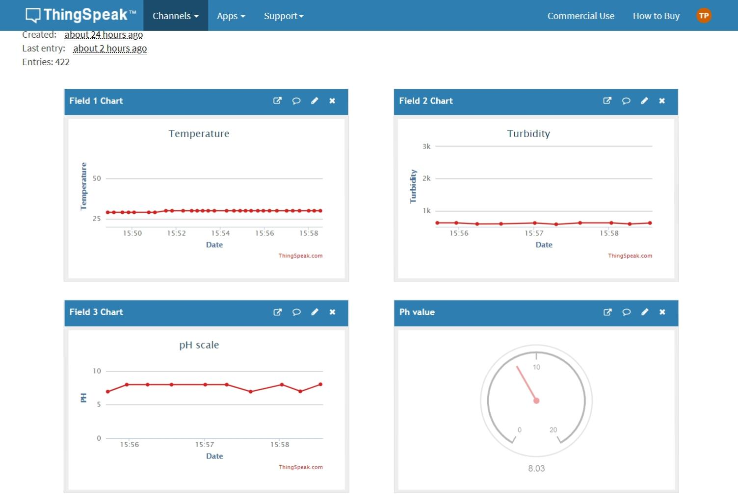
RESULTS
Cloud Layout for monitoring data

Slide 36
Conclusion
This project “IoT Based Eutrophication monitoring system” focused on monitoring the water quality in lake or pond with high performance, real time and accurate which measures Temperature, Turbidity and pH values of water with the help of Arduino Uno and various Sensors.
By getting the data , the values are calculated and compared it with threshold value. If it is below the normal value it will indicate as the value is low by alerting through buzzer.
The system can monitor water quality automatically, and it is low in cost and does not require people on duty. So the Eutrophication testing is likely to be more economical, convenient and fast.

Slide 37
Future scope
There are several other factors that concern the Eutrophication levels. Hence A collective data can be obtained from the water resources for each of the parameters.
A suitable interpretation software like MATLAB can be used to interpret the obtained data. Several lakes can altogether be monitored from a common station using this wireless network.
This can provide knowledge about the various lakes and suitable actions can be identified remotely from a single location.

Slide 38
References
[1] L. Hernández-Alpizar, A. Carrasquilla-Batista and L. Sancho-Chavarría, "IoT Application for
Water Quality Monitoring: Nitrates," 2020 IEEE 11th Latin American Symposium on Circuits
& Systems (LASCAS), San Jose, Costa Rica, 2020.
[2] R. P. N. Budiarti, A. Tjahjono, M. Hariadi and M. H. Purnomo, "Development of IoT for Automated
Water Quality Monitoring System," 2019 International Conference on Computer Science, Information
Technology, and Electrical Engineering (ICOMITEE), Jember, Indonesia,2019.
[3] J. J. Cancela, X.P. González, M. Vilanova, and J.M. Mirás-Avalos, ‘‘Water management using drones
and satellites in agriculture,’’ Water, vol. 11, no. 5, p. 874, Apr. 2019.

Slide 39
References
[4] Y. Zakaria and K. Michael, ‘‘An integrated cloud-based wireless sensor network for monitoring
industrial wastewater discharged into water sources,’’ Wireless Sensor Netw., vol. 09, no. 08, pp.
290–301, 2017.
[5] L. Jiang, K. Nielsen, O.B. Andersen, and P. Bauer-Gottwein, “Monitoring recent lake level variations
on the Tibetan Plateau using CryoSat-2 SARIn mode data,” J. Hydrol., vol. 544, pp. 109–124,
Jan.2017.
[6] H. Gao, C. Birkett, and D. P. Lettenmaier, “Global monitoring of large reservoir storage from satellite
remote sensing,” Water Resour. Res., vol. 48, no. 9, Sep. 2012, Art. no. W09504.

Slide 40
Thank You

